Slide 1
Socket Programming
Mahmuda Rawnak Jahan
Lecturer
Department of Computer Science & Engineering Military Institute of Science and Technology (MIST)
12.02.2019
Socket Programming

Slide 2
Outline
Client Server Model
Characteristics of a Client
Characteristics of a Server
Socket
Socket Abstraction
Socket Programming in Java
Client Side Programming
Server Side Programming
Lab Work
Client Side Implementation
Server Side Implementation
Assignment
Socket Programming

Slide 3
Client Server Model
TCP/IP allows two application programs to pass data back and forth
The applications can execute on the same machine or on different machines
How to organize the application programs?
Client-server paradigm is the most popular model
The communication applications are divided into two categories: client and server
Client-server paradigm uses the direction of initiation to categorize whether a program is a client or server.
Socket Programming

Slide 4
Client Server Model (Cont’d)
What is a Client?
An application that initiates the communication is called a client
E.g., Web browser, FTP client, Telnet client, Email client
The client contacts a server, sends a request, and awaits a response
What is a Server?
An application that waits for incoming communication requests from clients is called a server
E.g., Web server, FTP server, Telnet server, SMTP server
The server receives a clients request, performs the necessary computation, and returns the result to the client
A server is usually designed to provide service to multiple clients
Socket Programming

Slide 5

Client Server Model (Cont’d)
Figure: Client Server Model
Socket Programming

Slide 6
Characteristics of a Client
Arbitrary application program
Becomes client temporarily
Can also perform other computations
Invoked directly by user
Runs locally on users computer
Actively initiates contact with a server
Contacts one server at a time
Socket Programming

Slide 7
Characteristics of a Server
Special-purpose, privileged program
Dedicated to providing one service
Can handle multiple remote clients simultaneously
Invoked automatically when system boots
Executes forever
Needs powerful computer and operating system
Waits passively for client contact
Accepts requests from arbitrary clients
Socket Programming

Slide 8
How to Write Network Applications?
TCP/IP is implemented inside the OS
OS exports the TCP/IP functionalities through SOCKET APIs
API: Application Program Interface
A set of functions
Programmers develop network applications by using SOCKET APIs
To learn SOCKET programming
Learn some data structures
Learn the socket APIs
Learn multi-threading
Socket Programming

Slide 9
Socket
Socket is an interface between applications and the network services provided by OS
An application sends and receives data through a socket
What is a Socket?
A socket is simply an endpoint for communications between the machines.
Socket Programming

Slide 10
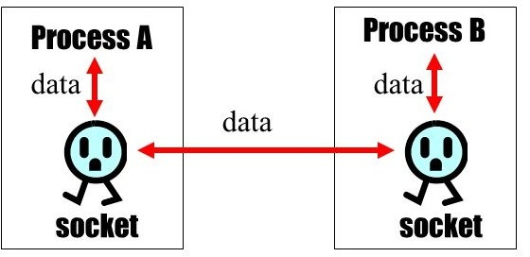
Socket Abstraction
Figure: Socket Abstraction
Socket Programming

Slide 11
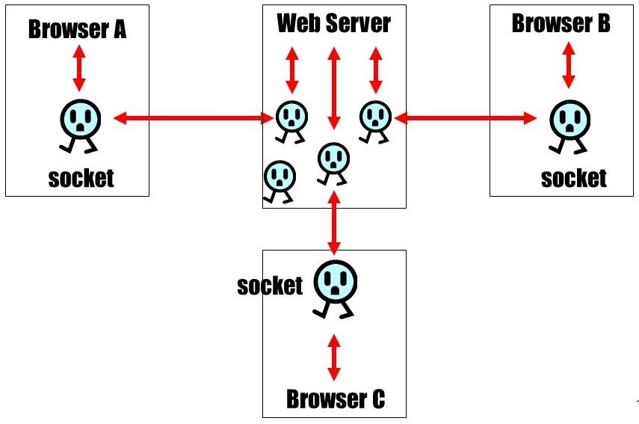
Socket Abstraction (Cont.)
Figure: Socket Abstraction
Socket Programming

Slide 12
Socket Programming in Java
Java Socket programming is used for communication between the applications running on different JRE.
Java Socket programming can be connection-oriented or connection-less.
Socket Programming

Slide 13
Client Side Programming
Establish a Socket Connection
To connect to other machine we need a socket connection.
A socket connection means the two machines have information about each others network location (IP Address) and TCP port.
Socket socket = new Socket(”127.0.0.1”, 5000)
First argument IP address of Server. ( 127.0.0.1 is the IP address of localhost, where code will run on single stand-alone machine).
Second argument TCP Port. (Just a number representing which application to run on a server. Port number can be from 0 to 65535). But port numbers between 0 and 1,023 are reserved for privileged users (Ex: email, FTP, and HTTP).
Communication
To communicate over a socket connection, streams are used to both input and output the data.
Closing the connection
The socket connection is closed explicitly once the message to server is sent.
Socket Programming

Slide 14
Server Side Programming
Establish a Socket Connection
To write a server application two sockets are needed.
A ServerSocket which waits for the client requests (when a client makes a new Socket())
A plain old Socket socket to use for communication with the client.
Communication
getOutputStream() method is used to send the output through the socket.
Closing the connection
After finishing, it is important to close the connection by closing the socket as well as input/output streams.
Socket Programming

Slide 15
Lab Work
Build a Client-Server model by java socket programming in which
client sends a message
and server receives it.
Socket Programming

Slide 16
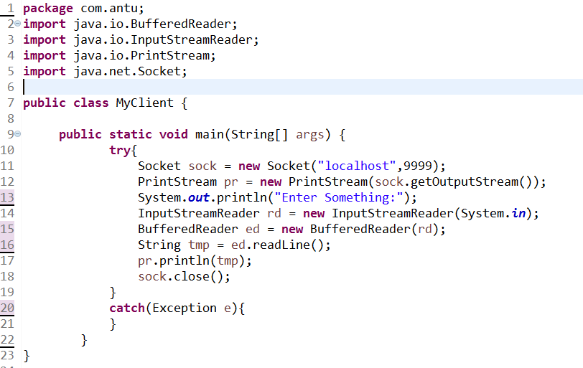
Client Side Implementation
Figure: Java code of Client
Socket Programming

Slide 17
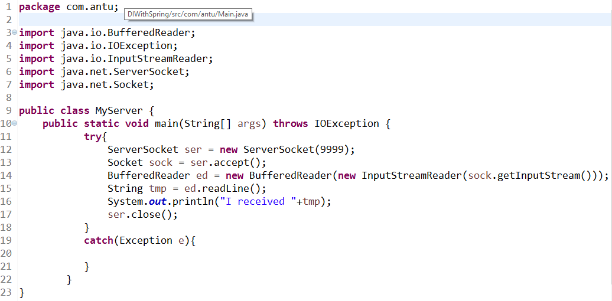
Server Side Implementation
Figure: Java code of Server
Socket Programming

Slide 18
Assignment
Build a Client-Server model by java socket programming in which
client sends a number
and server will return the factorial of that number.
Socket Programming

Slide 19

The End

